Slide 1
PS-MWC: A scalable, distributed maximum weight clique algorithm using Apache Spark
Qian Qiu
June 28, 2018

Slide 2
Contents
1. Introduction
2. Background
3. Methodology and Implementation
4. Experimental Evaluation
5. Conclusion
Notes:
In the introduction, I will briefly introduce the problem we try to solve, and the motivation of the thesis;
Then I will introduce some background knowledge of the techniques we use in the thesis;
Moreover, I will talk about the methodology and implementation of PS-MWC
Some experimental evaluation will be discussed
Finally, the concusion.

Slide 3
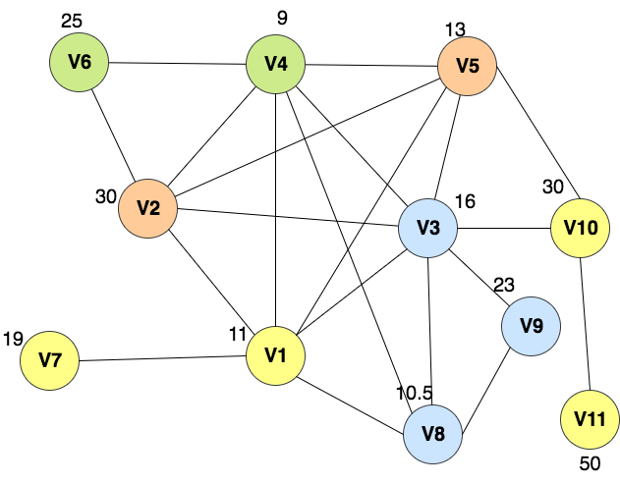
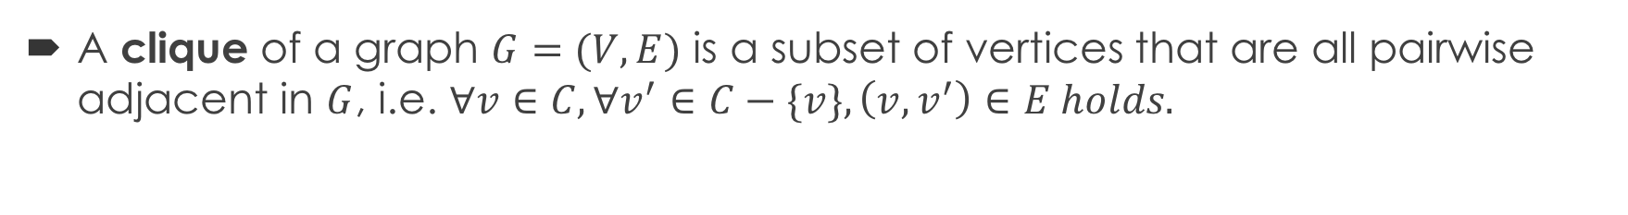
1. Introduction
A clique of a graph $G=(V, E)$ is a subset of vertices that are all pairwise adjacent in $G$, i.e. $∀v∈C, ∀v^{′}∈C−\{v\}, \left(v, v^{′}\right)∈E holds.$
e.g.
Each pair of adjacent nodes is a Clique of graph G: {v4, v6}, {v2, v5}, {v1, v7}…
{v3, v8, v9} is a Clique of G
Graph G
Notes:
Clique problems are fundamental problems in graph theory

Slide 4
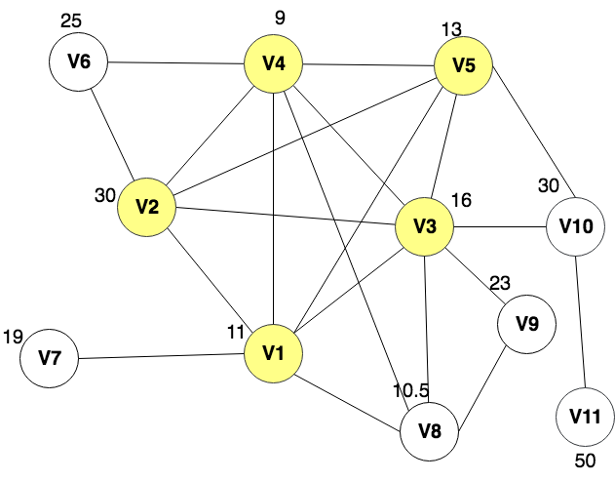
1. Introduction
Maximum Clique is a clique with the maximum number of vertices in the given graph
e.g.
{v1, v2, v3, v4, v5} is a Clique of G
This clique is the Maximum Clique of G
Graph G

Slide 5
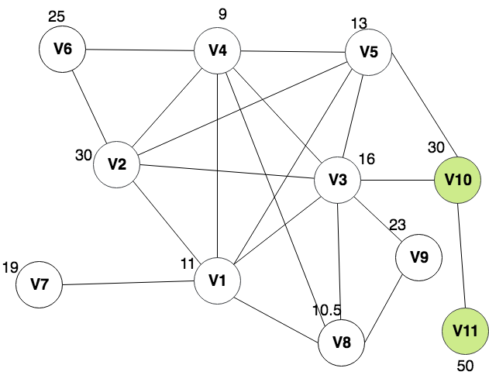
1. Introduction
Maximum Weight Clique (MWC) is a clique with maximum sum of vertices’ weights in the given graph
e.g.
weight{v10, v11} = 30 + 50 = 80
weight{v1, v2, v3, v4, v5} = 11 + 30 + 16 + 9 + 13 = 79
…
{v10, v11} is the Maximum Weight Clique of G
Graph G

Slide 6
1.1 MWC Applications
User analysis in social networks
By finding a group of people who all know each other with the maximum sum of weights
Node clustering in wireless networks [1]
By finding an independent set of nodes which can act as cluster-heads, for minimizing the amount of data to be exchanged
Scheduling in wireless networks [2]
By finding an independent set of nodes which can transmit maximal amount of data with no interference between arbitrary pairs of nodes
Railroad dispatching [3]
By finding a maximum set of non-conflicting train routes

Slide 7
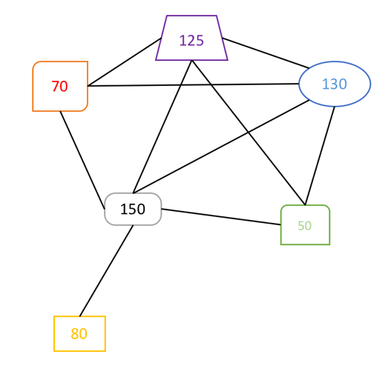
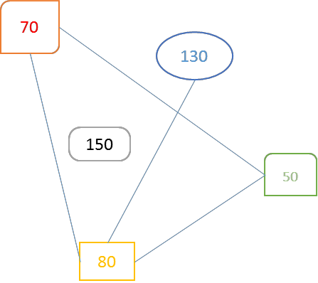
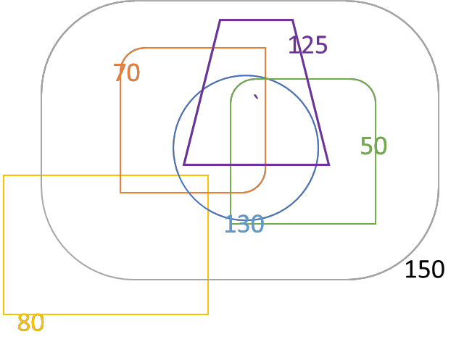
1.1 MWC Application in Hotspot Discovery Framework
a weighted overlap graph of hotspots
its complemental graph
a set of hotspots
By solving MWCP in this complemental graph , we can get a set of high-quality hotspots with a low degree of overlaps
Notes:
Our algorithm can be used to find an optimal set of hotspots:
Input: a set of hotspots, and an overlap threshold $λ, where 0 ≤λ≤1$
Output: a set of high-quality hotspots with a low degree of overlaps
Method:
Calculate reward value for each hotspot as its weight;
Create a weighted overlap graph of hotspots in which each vertex is a hotspot and there is an edge between two vertices if their degree of overlap is greater than the overlap threshold $λ$;
Find the maximum weight clique (MWC) in the complemental graph of this graph;
Return the union of all vertices in the MWCs

Slide 8
1.2 Motivations
MWC problem has many applications in wireless network telecommunications, railroad dispatching and social network analysis
MWC problem is NP-hard – No known polynomial-time solutions
The proliferation of massive data sets establishes the need for scalable algorithms to solve MWCPs for massive graph data

Slide 9
1.2 Motivations
Several heuristic or exact algorithms have been proposed – But most of them are sequential algorithms, i.e. they can only run on single machine
A parallel tabu search algorithm for MWCP has been proposed in [4], which doesn’t guarantee to find the best result, and is more suitable for dense graphs with smaller search space
This thesis aims to implement a distributed and scalable Maximum Weight Clique Algorithm Using Apache Spark, so that massive graphs can be distributed to multiple computers and be calculated in parallel

Slide 10
1.3 Main Ideas
Compute a clique quickly, and initialize global_max_weight
Choose the best candidate solution as final solution
Partition the whole graph into sub-problems
Solve sub-problems to get candidate solutions, and update global_max_weight
Prune sub-problems with global_max_weight
Notes:
initialize global_max with the weight of a clique we get in a quick way;
partition the whole graph into sub-problems in parallel;
solve sub-problems to get candidate solutions in parallel, update global_max;
prune sub-problems with global_max in partitioning step and solving step;
We calculate an upper bound for each sub-problem by adding up the weights of all vertices in this subgraph;
choose the best candidate solution as final solution

Slide 11
2. Background
2.1 Apache Spark
2.2 GraphX
2.3 Apache ZooKeeper

Slide 12
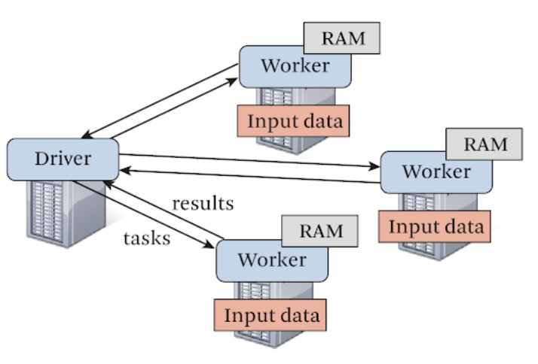
2.1 Apache Spark
Facilitates the implementation of iterative algorithms
Can work in memory with the minimal use of disk I/O
Provides both scalability and fault tolerance
Figure 2.1. Spark runtime. The user’s driver program launches multiple workers, which read data blocks from a distributed file system and can persist computed RDD partitions in memory [5].
Notes:
Spark is one of the most popular open-source Cluster Computing frameworks.
Spark uses a master/worker architecture. There is a driver that talks to a single coordinator called master that manages workers in which executors run.
A Spark driver (aka an application’s driver process) is a JVM process that hosts SparkContext for a Spark application. It is the master node in a Spark application.
Executor is a distributed agent that is responsible for executing tasks.

Slide 13
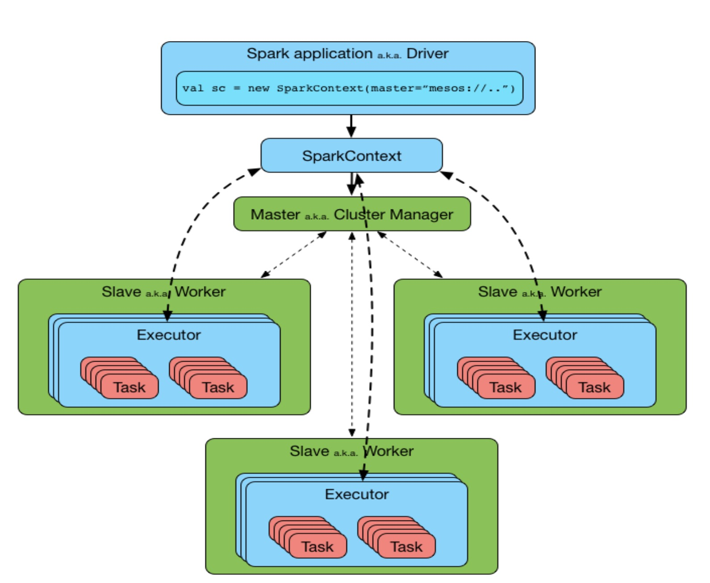
2.1 Apache Spark
Notes:
Spark Driver runs on the Master node, hosts SparkContext for the application, and negotiates with the Cluster Manager.
Driver requests Cluster Manager to assign tasks to executors
Driver groups set of tasks within the application into stages and create a DAG of stages. These stages are transformed into a set of tasks and scheduled for execution on the worker nodes via TaskScheduler.
Driver requests Cluster Manager to assign executors based on the data placement, i.e. to assign those executors running on the worker nodes, which contain the RDD partition on which tasks are to be run.
Executors running on each worker node register with the Driver to which they are assigned, and they run the task assigned to them by performing in-memory processing and computation.
The number of Executor processes running on the worker node can be one or more. Similarly, a single Executor can run one or more tasks concurrently.
The Cluster Manager contains information about all the resources across the compute nodes that together form the cluster. It is responsible for resource management in the cluster. Spark supports three different cluster managers, namely Standalone, YARN, and Mesos.

Slide 14
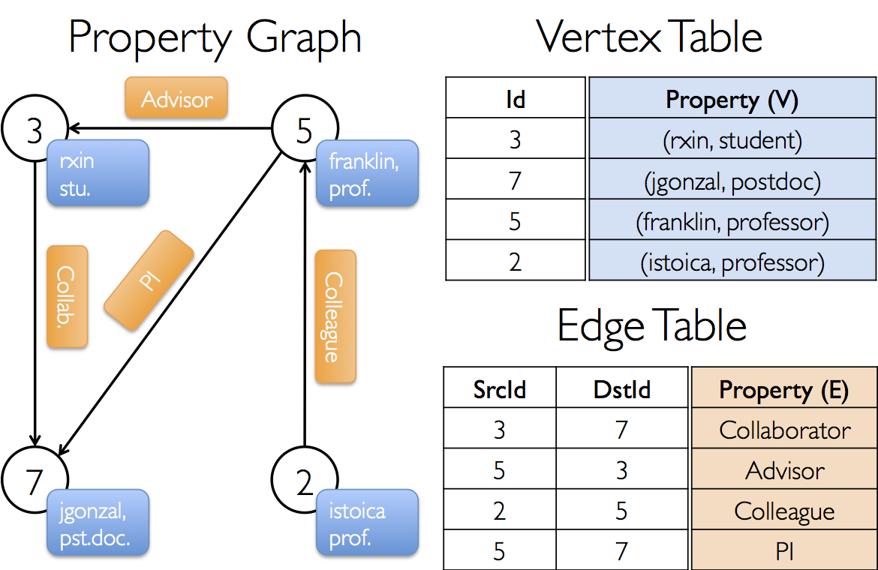
2.2 GraphX
A library in Apache Spark for graphs and graph-parallel computation
GraphX introduces a graph abstraction called property graph
GraphX provides three views of the property graph: vertex view, edge view, and triplet view
Notes:
Each vertex has an unique id and its property;
Each edge has an source vertex id, an destination vertex id, and its property.

Slide 15
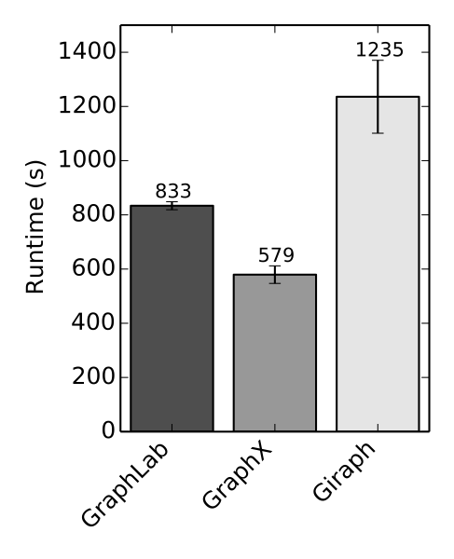
2.2 GraphX
Algorithms
GraphX provides multiple graph algorithms and builders to facilitate graph analytics and computation [9]
PageRank
Connected components
Label propagation
SVD++
Strongly connected components
Triangle count
End-to-end PageRank performance
(20 iterations, 3.7B edges) [9]
Notes:
GraphX comes with a variety of graph algorithms, many of which were contributed by our users.
Speed
Comparable performance to the fastest specialized graph processing systems.
GraphX competes on performance with the fastest graph systems while retaining Spark's flexibility, fault tolerance, and ease of use.

Slide 16
2.3 Apache ZooKeeper
In PS-MWC, we use the Apache ZooKeeper service to maintain a global mutable variable, which contains the weight of best solution found so far
Key benefits of ZooKeeper:
Fast
Reliable
Simple
Ordered
Notes:
ZooKeeper provides a very simple interface and services. ZooKeeper brings these key benefits:
Fast. ZooKeeper is especially fast with workloads where reads to the data are more common than writes. The ideal read/write ratio is about 10:1.
Reliable. ZooKeeper is replicated over a set of hosts (called an ensemble) and the servers are aware of each other. As long as a critical mass of servers is available, the ZooKeeper service will also be available. There is no single point of failure.
Simple. ZooKeeper maintain a standard hierarchical name space, similar to files and directories.
Ordered. The service maintains a record of all transactions, which can be used for higher-level abstractions, like synchronization primitives.
[https://hortonworks.com/apache/zookeeper/]
The first figure is the Client-server architecture of ZooKeeper;
The second figure is ZooKeeper data model
from [https://www.3pillarglobal.com/insights/test-execution-distributed-environment-using-zookeeper-poc?cn-reloaded=1]

Slide 17

3. Methodology and Implementation
GetQuickMWCL
Compute a clique quickly
Partition
Generate sub-problems
Solver
Solve sub-problems to get candidate solutions
ZKHelper
maintain global_max_weight in a znode
Main
The Driver program
Architecture of PS-MWC
Notes:
Implement PS-MWC using GraphX library in Scala
Use Apache ZooKeeper service to maintain and update the value of $global_max_weight$ which can be accessed by each executor
Improve the efficiency of PS-MWC in the light of Spark Tuning Guide
initialize global_max with the weight of a clique we get in a quick way;
partition the whole graph into sub-problems in parallel;
solve sub-problems to get candidate solutions in parallel, update global_max;
prune sub-problems with global_max in partitioning step and solving step;
choose the best candidate solution as final solution

Slide 18
3.1 Main Module
It creates SparkContext object, which communicates with the Cluster Manager;
It creates a property graph from the input text file stored in S3;
It calls GetQuickMWCL module for getting a clique quickly;
It calls ZKHelper module for connecting to ZooKeeper server, and initialize znode’s value;
It collects weightMap and neighborsMap for vertices, and broadcasts these two Maps to workers in the cluster.
It calls Partition module for partitioning the property graph into sub-problems.
It calls Solver model for solving sub-problems and getting candidate solutions;
It finds and outputs the final solution.
Notes:
It creates SparkContext object, which communicates with the Cluster Manager;
It creates a property graph from the input file;
It calls GetQuickMWCL module for getting a clique quickly;
It calls ZKHelper module for connecting to ZooKeeper server, and initialize znode’s value;
It collects weightMap and neighborsMap for vertices, and broadcasts these two Maps to workers in the cluster. The weightMap contains the key-value pairs of vertex id and vertex weight; while the neighborsMap contains the key-value pairs of vertex id and a set of its neighbors’ ids. This ensures such information is available in memory for all workers, so that workers can solve sub-problems which are assigned to it independently.
It calls Partition module for partitioning the property graph into sub-problems. Specifically, we define a class called Subproblem which has three fields: partition_path, upperBound, and vertexSet. The partition_path, stated in Section 3.2.3, is a list of vertex ids which indicates how the subgraph is obtained from the original graph. In our current implementation, each partition_path contains a vertex because we perform partitioning one time, however, it can contain more vertices if we perform multiple times of partitioning. The upperBound is a long-type value which is the sum of weights of all vertices in this sub-problem, denotes the upper bound of the weight of MWC in this sub-problem. The vertexSet contains a set of higher-order neighbors of vertices in partition_path.
It calls Solver model for solving sub-problems and getting candidate solutions;
It finds and outputs the final solution.

Slide 19
3.2 GetQuickMWCL Module
Take a subgraph with 500 vertices from the input property graph
Define an ordering object in which vertices are ordered by weight and then degree
Based on this ordering, we construct a clique by keep choosing the vertex with the maximum weight and degree from candidate set which contains vertices can be added into the current clique.
Notes:
(1) set candidatesSet to be a subset of vertices in the graph; clique := {}
(2) add $v$with highest weight and degree in the candidatesSet to the clique
(3) candidatesSet := candidatesSet $∩$ N($v$); N($v$) denotes neighbors of $v$
(4) go to step (2) until candidatesSet become empty
(5) return clique
the clique$C$ is constructed by keep removing the vertex with highest weight and degree* in $candidateSet$ until $CandSet$ become empty.
var max_weight_degree_vertex: (VertexId, (Double, Int)) = degreeGraph.vertices.max()(orderingByWeightAndDegree)
Tested graph: # of nodes: 7393; # of edges: 25569
Quickly get a mwcl with weight value 400.0 in 780 ms

Slide 20
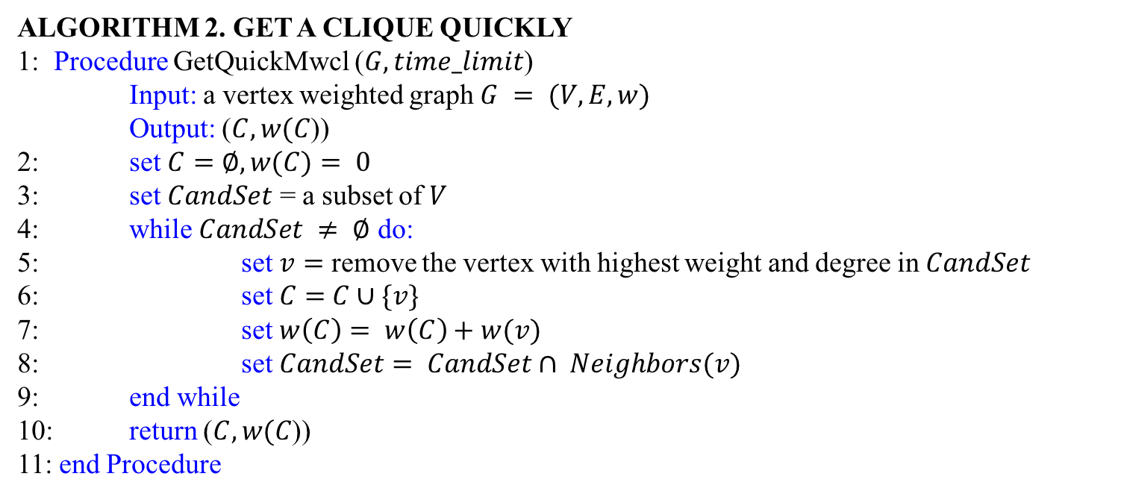
3.2 GetQuickMWCL Module
Algorithm 2. Get A Clique Quickly
1: Procedure GetQuickMwcl ($G, time_limit$)
Input: a vertex weighted graph $G = (V, E, w)$
Output: ($C,w(C$))
2: set $C=∅, w(C)= 0$
3: set $CandSet$ = a subset of $V$
4: while $CandSet ≠ ∅$ do:
5: set $v=$ remove the vertex with highest weight and degree in $CandSet$
6: set$C=$ $C∪\{v\}$
7: set $w\left(C\right)= w\left(C\right)+w(v)$
8: set $CandSet= CandSet∩ Neighbors(v)$
9: end while
10: return ($C,w(C$))
11: end Procedure

Slide 21
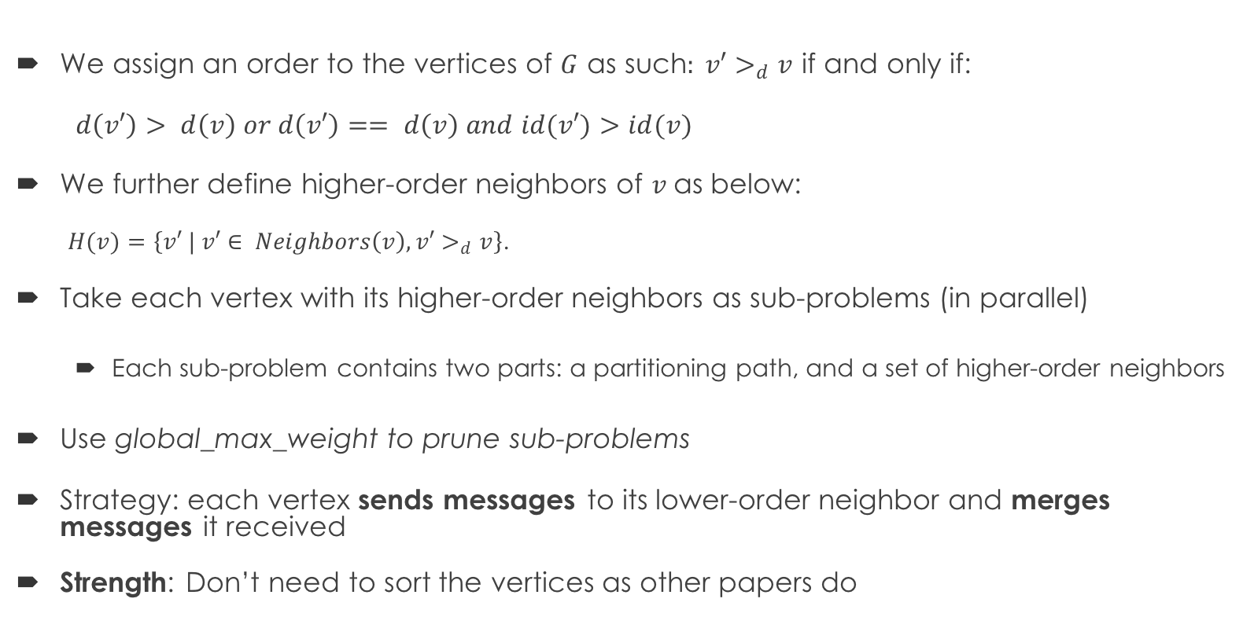
3.3 Partition Module
We assign an order to the vertices of $G$ as such$: v′>_{d}v$ if and only if:
$d\left(v′\right)> d\left(v\right) or d\left(v′\right)== d\left(v\right) and id(v′)>id(v)$
We further define higher-order neighbors of $v$as below:
$H(v)=$ $\left\{v′ | v′∈ Neighbors\left(v\right), v′>_{d}v\right\}$.
Take each vertex with its higher-order neighbors as sub-problems (in parallel)
Each sub-problem contains two parts: a partitioning path, and a set of higher-order neighbors
Use global_max_weight to prune sub-problems
Strategy: each vertex sends messages to its lower-order neighbor and merges messages it received
Strength: Don’t need to sort the vertices as other papers do
Notes:
In order to balance the size of sub-problems and reduce overlap, we assign an order to vertices in the graph
We use this ordering because it achieves balanced workload
There are some papers for partitioning maximal clique problem. Their partitioning strategy is to firstly order all vertices, and take vertices one by one to generate sub-problems

Slide 22
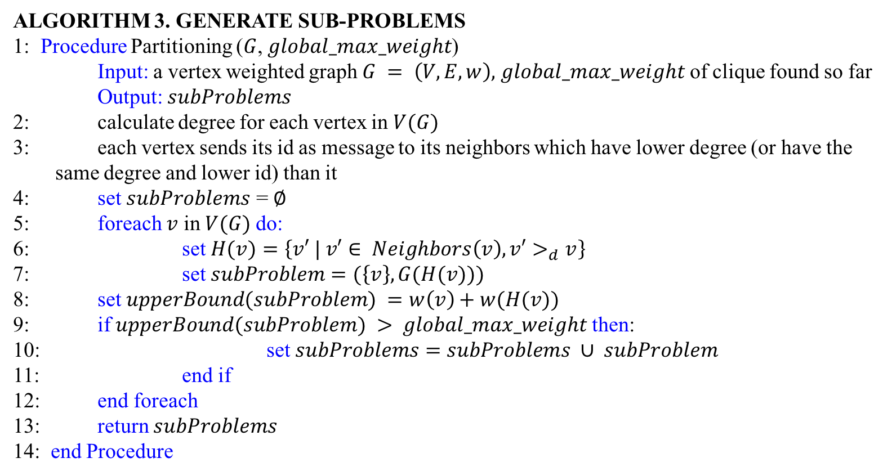
3.3 Partition Module
Algorithm 3. Generate Sub-Problems
1: Procedure Partitioning ($G$, $global_max_weight$)
Input: a vertex weighted graph $G = \left(V, E, w\right),$ $global_max_weight$ of clique found so far
Output: $subProblems$
2: calculate degree for each vertex in $V(G)$
3: each vertex sends its id as message to its neighbors which have lower degree (or have the same degree and lower id) than it
4: set $subProblems$ = $∅$
5: foreach $v$ in $V(G)$do:
6: set $H(v)=$ $\left\{v′ | v′∈ Neighbors\left(v\right), v′>_{d}v\right\}$
7: set $subProblem=(\left\{v\right\}, G(H(v)))$
8: set $upperBound(subProblem) =w\left(v\right)+w(H(v))$
9: if $upperBound(subProblem) > global_max_weight$then:
10: set $subProblems=$ $subProblems ∪ subProblem$
11: end if
12: end foreach
13: return $subProblems$
14: end Procedure

Slide 23
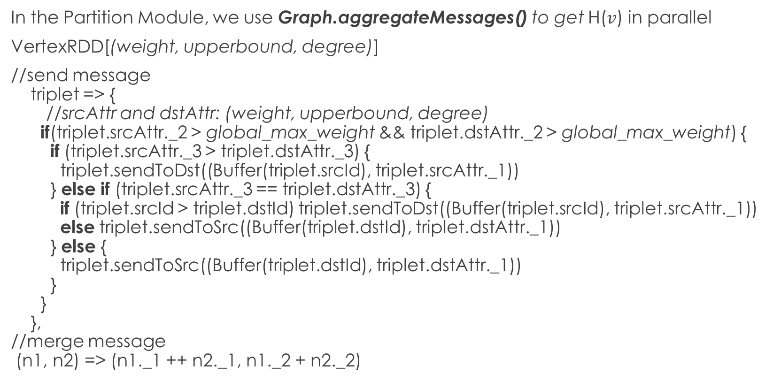
3.3 Partition Module
In the Partition Module, we use Graph.aggregateMessages() to get H($v$) in parallel
VertexRDD[(weight, upperbound, degree)]
//send message triplet => { //srcAttr and dstAttr: (weight, upperbound, degree) if(triplet.srcAttr._2 > global_max_weight && triplet.dstAttr._2 > global_max_weight) { if (triplet.srcAttr._3 > triplet.dstAttr._3) { triplet.sendToDst((Buffer(triplet.srcId), triplet.srcAttr._1)) } else if (triplet.srcAttr._3 == triplet.dstAttr._3) { if (triplet.srcId > triplet.dstId) triplet.sendToDst((Buffer(triplet.srcId), triplet.srcAttr._1)) else triplet.sendToSrc((Buffer(triplet.dstId), triplet.dstAttr._1)) } else { triplet.sendToSrc((Buffer(triplet.dstId), triplet.dstAttr._1)) } } }, //merge message (n1, n2) => (n1._1 ++ n2._1, n1._2 + n2._2)
Notes:
For each $v_{i}$ in graph :
$v_{i}$ sends its id as message to its neighbors which have lower degree (or have the same degree and lower id) than it;
By merging the messages received by $v_{i}$, we get H($v_{i}$);
//discard the subproblem if it cannot get a better clique
If weight($v_{i}$) + weight(H($v_{i}$)) > global_max:
$\text{subProblems}\text{ = }\text{subProblems}∪\text{(\{}v_{i}\text{\},}\text{H}\text{ (}v_{i}\text{))}$

Slide 24
3.3 Partition Module
Graph.aggregateMessages() is provided in Spark GraphX library.
This function transfers messages along the neighboring edges and from neighboring vertices to each vertex, and merges messages for each vertex.
Its first parameter is the type of message to be sent to each vertex.
The second parameter is sendMsg() function defined by user, which runs on each edge and sends messages to neighboring vertices.
The third parameter is mergeMsg() function defined by user, which combines messages destined to the same vertex.
Notes:
Graph.aggregateMessages() is provided in Spark GraphX library. This function transfers messages along the neighboring edges and from neighboring vertices to each vertex, and merges messages for each vertex. It has four parameters. The first parameter is the type of message to be sent to each vertex. In our implementation, we set it to be a tuple consists of a Buffer[VertexId], in which we put each vertex’s higher-order neighbor’s id, and a Double value, which is the weight of this higher-order neighbor. The second parameter is sendMsg() function defined by user, which runs on each edge and sends messages to neighboring vertices. In our implementation, only vertices which have upper bound value greater than $global_max_weight$ can send and receive messages, avoiding unnecessary costs. Messages are sent from higher-order vertices to its lower-order neighbors. The third parameter is mergeMsg() function defined by user, which combines messages destined to the same vertex. In our implementation, we merge the higher-order neighbor’s id into a buffer for each vertex, and add up their weights. The fourth parameter is tripletFields, by which users can specify which fields should be used in sendMsg() function. If tripletFields is not defined, then all fields in triplets would be used by default.

Slide 25
3.4 Solver Module
Sub-problems are solved in parallel
We can use any state-of-art MWC algorithms in this step
We use FastWClq algorithm in [6] in PS-MWC
Main Ideas of FastWClq :
A function for estimating the benefit of adding a vertex
A BMS heuristic for choosing the adding vertex
A fast and effective graph reduction algorithm
While getting cliques with greater weight than global_max_weight, update global_max_weight to be greater value
For each sub-problem, use global_max_weight to prune it before and during solving it

Slide 26
3.5 ZKHelper Module
Through ZKHepler module, Driver program connects to ZooKeeper server, creates znode /MWCL and initialize its value to be weight of clique we get in step1;
Through ZKHepler module, Executors connect to ZooKeeper server, read value of znode /MWCL, and update this value when a clique with greater weight is found;
startZK() is called by driver and executors, to initiate a client connection to ZooKeeper server;
initializeZNode() is called by driver, to create the znode and initialize it with the input value;
readWeightFromZookeeper() is called by driver and executors, to read the data in the znode;
updateZNode() is called by executors, to update the data in the znode.
Notes:
We use ZooKeeper to maintain a mutable global variable: weight of best clique we found so far, and prune sub-problems with this variable.
Driver program connects to ZooKeeper server, creates znode /MWCL and initialize its value to be weight of clique we get in step1;
Executors connect to ZooKeeper server, read value of znode /MWCL, and update this value when a clique with greater weight is found;
If the sum of weights of all vertices in a sub-problem is lower than or equal to value of znode /MWCL, we discard this sub-problem

Slide 27
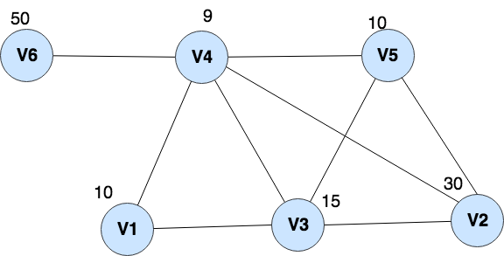
3.6 A Small Example

Slide 28
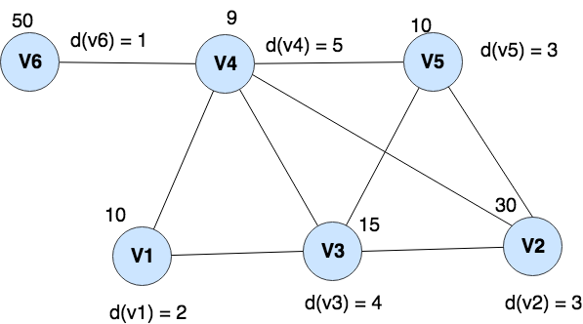
3.6 A Small Example – Step 1
Step 1: Get a clique quickly
Strategy: choose from the candidate set the vertex which has maximum weight into a clique
Clique: {v4, v6}
Weight of clique: 59
set global_max_weight = 59

Slide 29
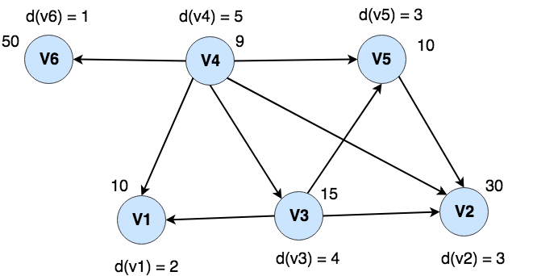
3.6 A Small Example – Step 2
Step 2. Get higher-order neighbors for each vertex, and then take each vertex with its higher-order neighbors as sub-problems (in parallel)
Strategy: each vertex sends messages to its lower-order neighbor and merges messages it received
Strength: Don’t need to sort the vertices as other papers do
The arrow denotes the direction of messages

Slide 30
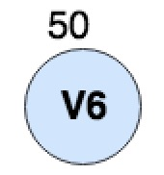
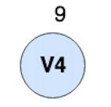
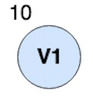
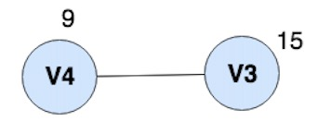
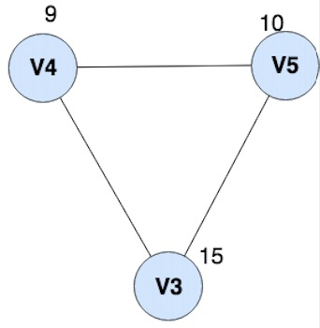
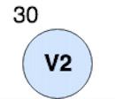
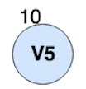
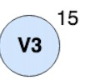
3.6 A Small Example – Step 2
50 + 9 <= 59, pruned
10 + 9 + 15 <= 59, pruned
30+9+10+15>59
Solve it and get
a candidate solution:
{v2, v3, v4, v5}
10 + 9 + 15 <= 59, pruned
We can prune the sub-problems using global_max_weight
15 + 9 <= 59, pruned
9 <= 59, pruned

Slide 31
3.7 Improve Efficiency by Tuning
Data Serialization
Use Kryo serialization instead of default Java serialization
Java serialization (default; can work with any class implements java.io.Serializable)
Kryo serialization (significantly faster and more compact than Java serialization; does not support all Serializable types; need to register the classes used in the program)
Time cost is reduced by 10% when tested on a dataset called web-uk-2005

Slide 32
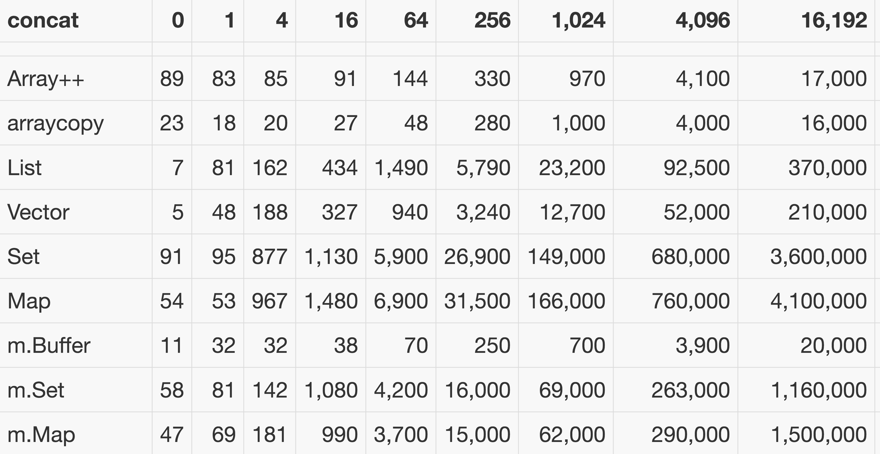
3.7 Improve Efficiency by Tuning
Data Structures
Use mutable.Buffer as the type of messages instead of Set
Time cost is reduced by 14% when tested on dataset web-uk-2005
Concatation performance comparison between collections [10]
Notes:
Idea: choose the best data structure for certain computation
Frequent computation in our implementation:
graph.aggregateMessages(sendMsg, mergeMsg)
This function sends vertex’s id from higher-order vertices to their neighbors; and then merge the ids in received messages into one collection for each vertex.
Thus, we need to choose data structure with the best concat efficiency

Slide 33
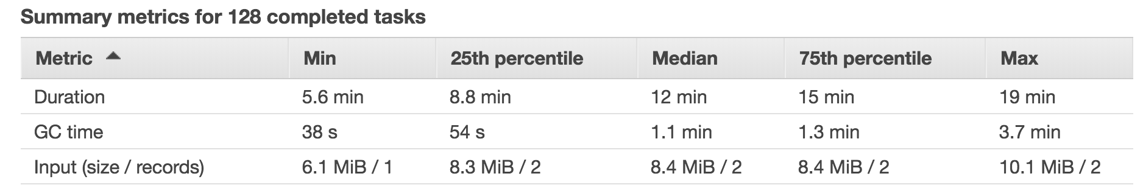
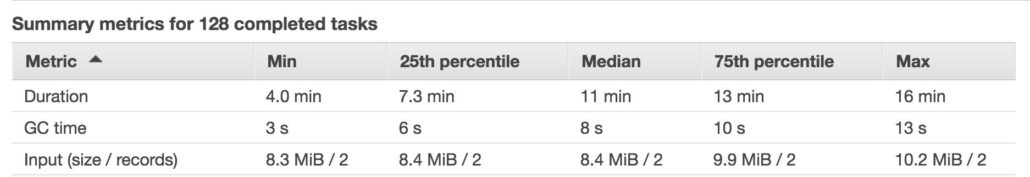
3.7 Improve Efficiency by Tuning
Garbage Collection
Use G1GC garbage collector instead of default garbage collector
Figure a. GC time using default garbage collector.
Figure b. GC time using G1GC garbage collector.

Slide 34
4. Experimental Evaluation
4.1 Datasets and Measures
4.2 Platform
4.3 Experimental Results
4.3.1 Comparison of Solution Quality
4.3.2 Runtime Comparison of Different Strategies
4.3.3 Evaluation of Partitioning Properties
4.3.4 Scalability

Slide 35
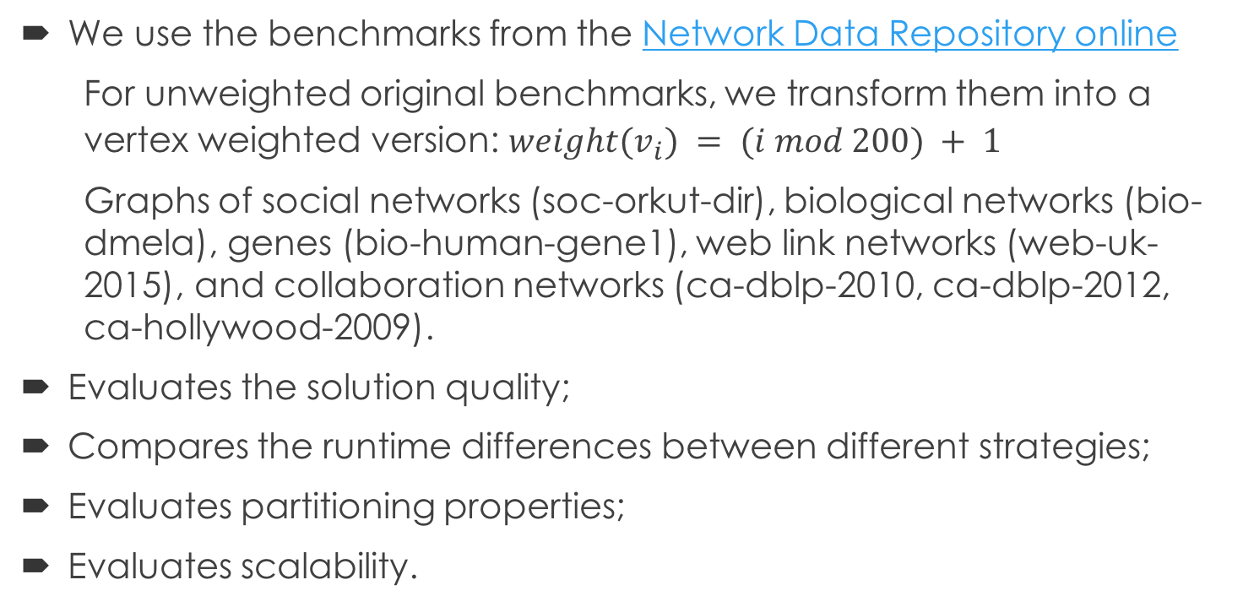
4.1 Datasets and Measures
We use the benchmarks from the Network Data Repository online
For unweighted original benchmarks, we transform them into a vertex weighted version: $weight(v_{i}) = (i mod 200) + 1$
Graphs of social networks (soc-orkut-dir), biological networks (bio-dmela), genes (bio-human-gene1), web link networks (web-uk-2015), and collaboration networks (ca-dblp-2010, ca-dblp-2012, ca-hollywood-2009).
Evaluates the solution quality;
Compares the runtime differences between different strategies;
Evaluates partitioning properties;
Evaluates scalability.

Slide 36
4.2 Platform
A standalone machine
With a 2.8GHz quad-core Intel Core i7 processor and 16G memory
Two Amazon EMR clusters
One EMR cluster consists of one master node and seven worker nodes, while the other EMR cluster consists of one master node and 15 worker nodes
The master node is of m4.2xlarge type, which contains 16 cores and 32 GB memory
The worker nodes are of m3.xlarge type, each of which contains 8 cores and 15 GB memory
The nodes in the EMR clusters read input datasets from Amazon S3, an AWS data store, where we store the datasets.

Slide 37
4.3.1 Comparison of Solution Quality
Graph | |V| | |E| | Density | Solution of FastWClq [6] | Solution of WLMC [5] | Solution of PS-MWC
bio-dmela | 7.4K | 25.6K | 0.0009 | 805 | 805 | 805
ca-dblp-2010 | 226.4K | 716.5K | 2.8e-05 | 7575 | 7575 | 7575
ca-dblp-2012 | 317.1K | 1M | 2.09e-05 | 14108 | 14108 | 14108
web-uk-2015 | 129.6K | 11.7M | 0.0014 | 54850 | 54850 | 54850
ca-hollywood-2009 | 1.1M | 56.3M | 9.85e-05 | 222720 | 222720 | 222720
Table 4.1. Comparison of Solution Quality
Notes:
On paper <Fast Solving Maximum Weight Clique Problem in Massive Graphs>, it shows some result of several algorithms on some graph data in Network Data Repository online. We run our algorithm on the same dataset and compare our result with theirs.

Slide 38
4.3.2 Runtime Comparison of Different Strategies
Graph | |V| | |E| | Strategy_0 | Strategy_1 | Strategy_2 | Strategy_3
bio-dmela | 7.4K | 25.6K | 2.07 s | 15.435 s | 1.981 s | 1.917 s
ca-dblp-2010 | 226.4K | 716.5K | 7.638 s | Longer than 5 mins | 10.4 s | 15.480 s
ca-dblp-2012 | 317.1K | 1M | 11.683 s | Longer than 5 mins | 41.888 s | 30.406 s
web-uk-2015 | 129.6K | 11.7M | 40.225 s | Longer than 20 mins | 273 s | Longer than 20 mins
Table 4.2. Runtime Comparison of Different Strategies
This experiment run on local[4]; Processor: 2.8GHz quad-core Intel Core i7; Memory: 16G
Strategy_0: partition the graph based on degree and then vertex id; use Zookeeper; is adopted in PS-MWC. Strategy_1: do not partition the graph; use Zookeeper; Strategy_2: partition the graph based on vertex id; use Zookeeper;
Strategy_3: use the same partitioning strategy as strategy_0; use a broadcast variable instead of ZooKeeper for pruning
Notes:
In strategy_0, we partition the input graph basing on vertices’ degree and then vertices’ id, and use the ZooKeeper service to maintain a global best solution found so far for pruning the sub-problems. This strategy is adopted in PS-MWC.
In strategy_1, we don’t partition the input graph into sub-problems, which means we skip the partitioning step and directly solve the original graph in solving step.
In strategy_2, we partition the input graph basing on vertices’ id, and use the ZooKeeper service.
In strategy_3, we partition the input graph basing on vertices’ degree and then vertices’ id, which is the same partitioning strategy as strategy_0, but do not use the ZooKeeper service for pruning. Instead, we use a broadcast variable which contains the weight value of the clique we get quickly.

Slide 39
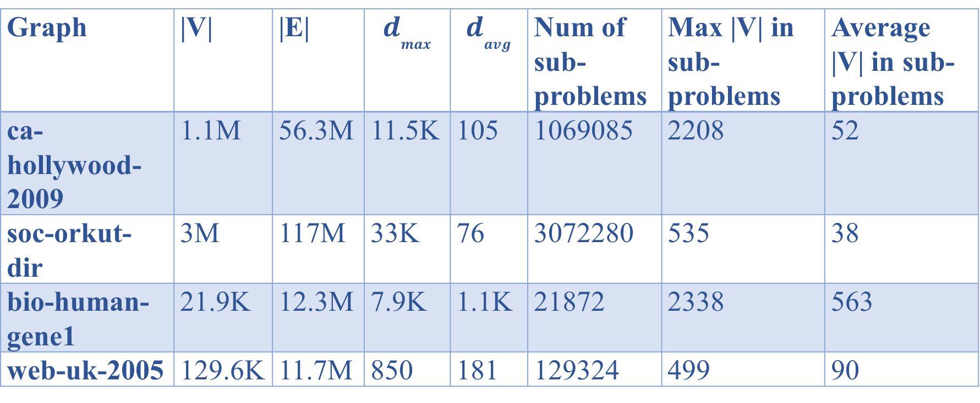
4.3.3 Evaluation of Partitioning Properties
Graph | |V| | |E| | $$d_{max}$$ | $$d_{avg}$$ | Num of sub-problems | Max |V| in sub-problems | Average |V| in sub-problems
ca-hollywood-2009 | 1.1M | 56.3M | 11.5K | 105 | 1069085 | 2208 | 52
soc-orkut-dir | 3M | 117M | 33K | 76 | 3072280 | 535 | 38
bio-human-gene1 | 21.9K | 12.3M | 7.9K | 1.1K | 21872 | 2338 | 563
web-uk-2005 | 129.6K | 11.7M | 850 | 181 | 129324 | 499 | 90
Table 4.3. Partitioning Properties
Notes:
The results show that after partitioning, the maximum size of sub-problems is much smaller than the maximum degree of vertices in the input graph. We may conclude that the partitioning strategy is robust to skewed degree distribution, in which quite few vertices have very large degree. Take the graph soc-orkut-dir as an example, the maximum degree of vertices is 33K while the total number of vertices is 3M, after partitioning, the maximum number of graphs in sub-problems is 535.

Slide 40
4.3.4 Scalability
Graph | |V| | |E| | Density | Time Cost(s)
G1 | 614,488 | 17,941,635 | 9.5e-05 | 147
G2 | 1,228,976 | 43,377,222 | 5.7e-05 | 483
G3 | 1,843,464 | 73,911,110 | 4.3e-05 | 981
G4 | 2,457,952 | 96,137,820 | 3.1e-05 | 1342
G5 | 3,072,441 | 117,185,083 | 2.5e-05 | 1349
Table 4.4. Runtime Comparison of Five Graphs
G5 is a massive data set, soc-orkut-dir.
Based on G5, we generate its subgraphs G1, G2, G3, and G4 using the following procedure. G1 is induced by 1/5 of vertices in G5. G2 is induced by 2/5 of vertices in G5, and so on.
Compute Nodes: EMR; No. of Executors: 8; No. of Executor cores: 8; Executor memory: 8G

Slide 41
4.3.4 Scalability
Graph | |V| | Time Cost (s) | # of sub-problems pruned in partitioning step | # of sub-problems pruned in solving step | Total # of sub-problems pruned | Pruned percentage | Total # of sub-problems solved
G1 | 614,488 | 147 | 48 | 613555 | 613603 | 99.86% | 885
G2 | 1,228,976 | 483 | 66 | 1226636 | 1226702 | 99.80% | 2274
G3 | 1,843,464 | 981 | 71 | 1840809 | 1840880 | 99.86% | 2584
G4 | 2,457,952 | 1342 | 120 | 2455106 | 2455226 | 99.89% | 2726
G5 | 3,072,441 | 1349 | 161 | 3069268 | 3069429 | 99.90% | 3012
Table 4.5. Pruning Efficiency

Slide 42
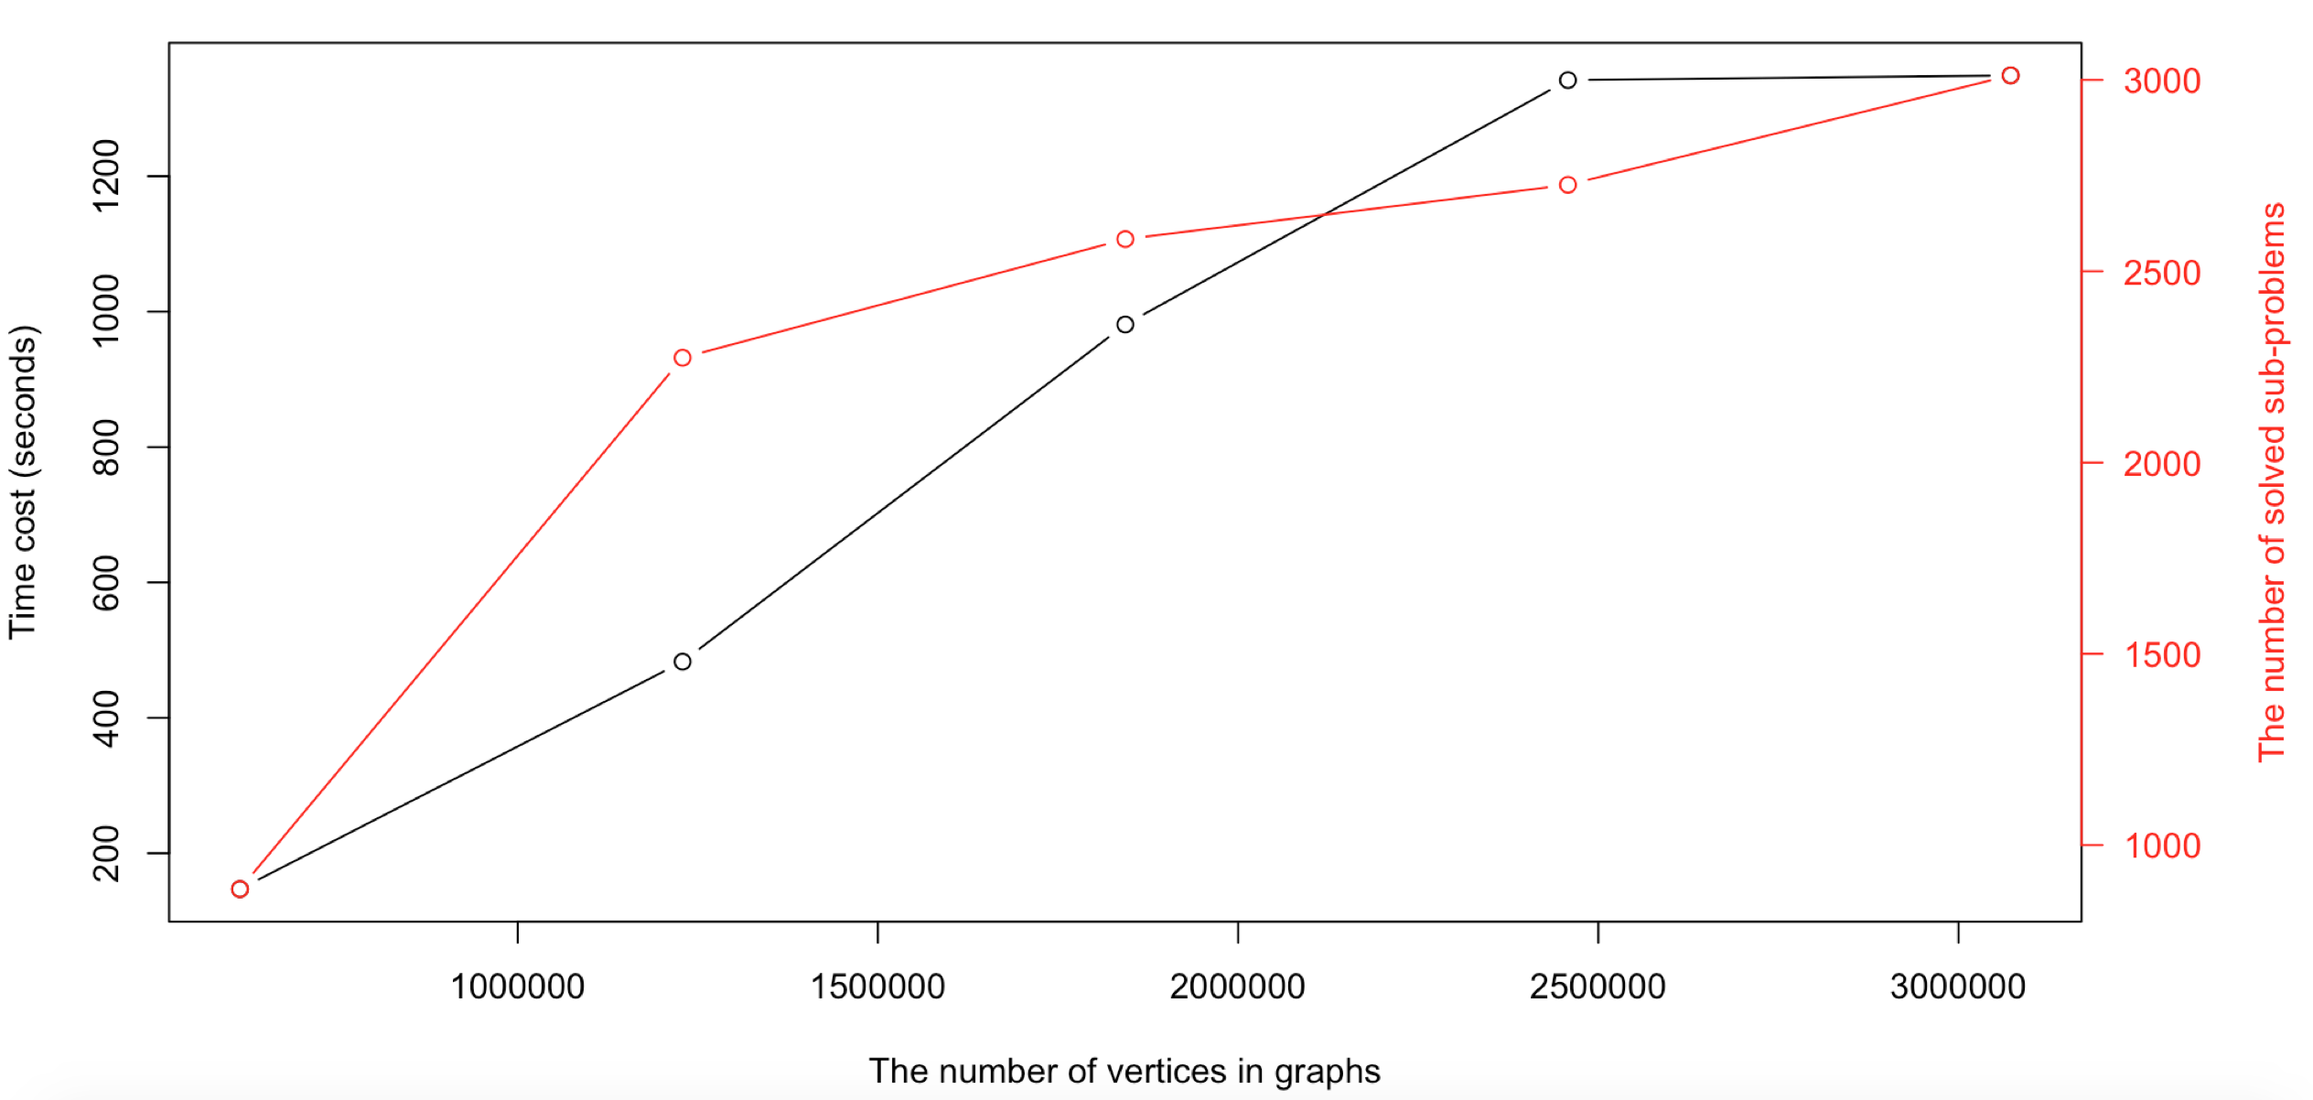
4.3.4 Scalability
Figure 4.1. Time cost and solved sub-problems number when applying PS-MWC on graphs with different number of vertices.

Slide 43
4.3.4 Scalability
Graph | |V| | |E| | Number of cores | Time Cost(s)
G4 | 2,457,952 | 96,137,820 | 64 | 1342
 |  |  | 128 | 539
G5 | 3,072,441 | 117,185,083 | 64 | 1349
 |  |  | 128 | 575
Table 5.6. Performance evaluation when increasing the number of cores
Notes:
As is indicated in Table 5.6, for the graph G5 with more than 3 million vertices and more than 117 million edges, PS-MWC takes 1349 and 575 seconds on an EMR cluster with 64 and 128 cores respectively.
The results show that when the cores of executors in EMR cluster doubles, the time cost decreases by more than two times. This demonstrates good scalability.
Based on the results, we are confident that PS-MWC can solve the MWCP for massive datasets which contain millions of vertices and hundreds of millions of edges.
In order to process larger graphs, PS-MWC merely requires more memory and cores to efficiently solve the MWCP.

Slide 44
5. Conclusion
PS-MWC is efficient, distributed and scalable
It can solve MWCP on massive graphs which cannot be solved within reasonable time on a single processor
In order to process larger graphs, PS-MWC merely requires more memory and cores to efficiently solve the MWCP
Limitation: not suitable for dense graphs
Future work
Run ZooKeeper in replicated mode to avoid single point of failure;
Utilize the GraphFrame library, which supports all the operators available in GraphX, to see if it can achieve better efficiency;
Explore an efficient alternative approach for getting a clique quickly;
Integrate PS-MWC with a spatial hotspot discovery framework [7, 8]

Slide 45
References
[1] S. Basagni. Finding a maximal weighted independent set in wireless networks. Telecommunication Systems, 18(1-3):155–168, 2001.
[2] S. Sanghavi et al. Message-passing for maximum weight independent set. 2015
[3] H. Flier et al. Vertex disjoint paths for dispatching in railways. In Proceedings of ATMOS, pages 61– 73, 2010.
[4] Kiziloz, Dokeroglu, A robust and cooperative parallel tabu search algorithm for the maximum vertex weight clique problem. Computers & Industrial Engineering. 118(2018), 54-66.
[5] Matei Zaharia. An Architecture for Fast and General Data Processing on Large Clusters. p16. 2016.
[6] Cai, S. W. et al. Fast solving maximum weight clique problem in massive graphs. In Proceedings of 25th International Joint Conference on Artificial Intelligence, IJCAI, 568–574, 2016.
[7] Akdag F., Eick C.F. (2016) Interestingness Hotspot Discovery in Spatial Datasets Using a Graph-Based Approach. In: Perner P. (eds) Machine Learning and Data Mining in Pattern Recognition. MLDM 2016. Lecture Notes in Computer Science, vol 9729. Springer, Cham.
[8] Akdag F., Eick C.F. (2014). A Computational Framework for Finding Interestingness Hotspots in Large Spatio-Temporal Grids. In Proceedings of the 3rd ACM SIGSPATIAL International Workshop on Analytics for Big Geospatial Data (BigSpatial-2014). ACM, Dallas, TX, 21-29.
[9] https://spark.apache.org/graphx/
[10] Benchmarking Scala Collections http://www.lihaoyi.com/post/BenchmarkingScalaCollections.html

Slide 46
THANK YOU

